Slide 1
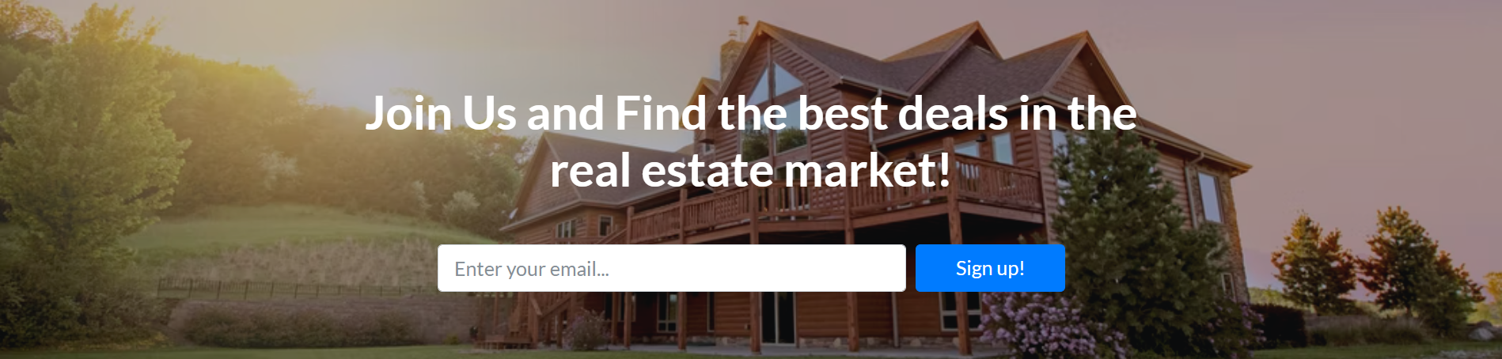
REAL-ESTATE MANAGEMENT SYSTEM
Pitch

Slide 2
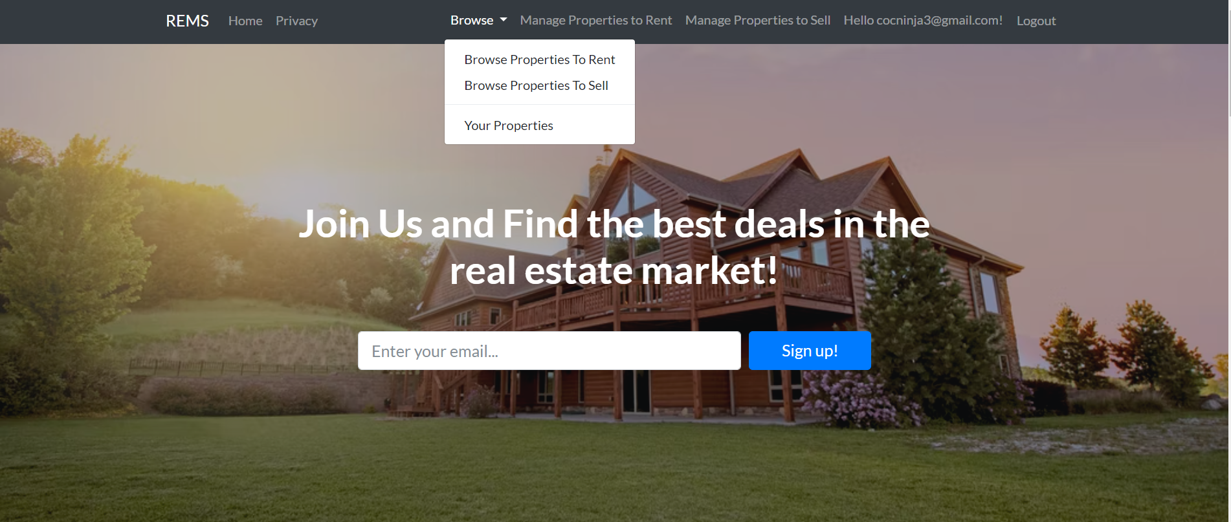
About PROJECT:
This is semester project of DATABASE SYSTEM course. In REMS we can manage properties for rent & sale. This projects brings ease & feasibility in context of browsing for types of properties: Like, Commercial, Residential, Agricultural.
About

Slide 3
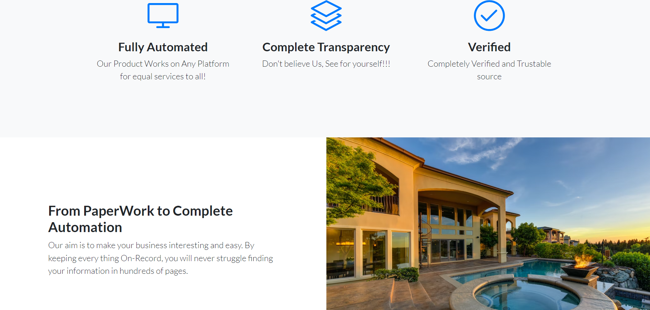
Problem
Market gap
Customers
Financials
Property-Agent need new software solutions but are using old or outdated tools and services​
Customer % decreases because they don’t see the desired properties with ease.
It make sures the authenticity of the properties. Which led to the strong financials
Costs
Usability
Loss of potential income by not offering new tools for agency workers ​
People want something that’s easy to adopt and simple to use for buying & selling properties

Slide 4
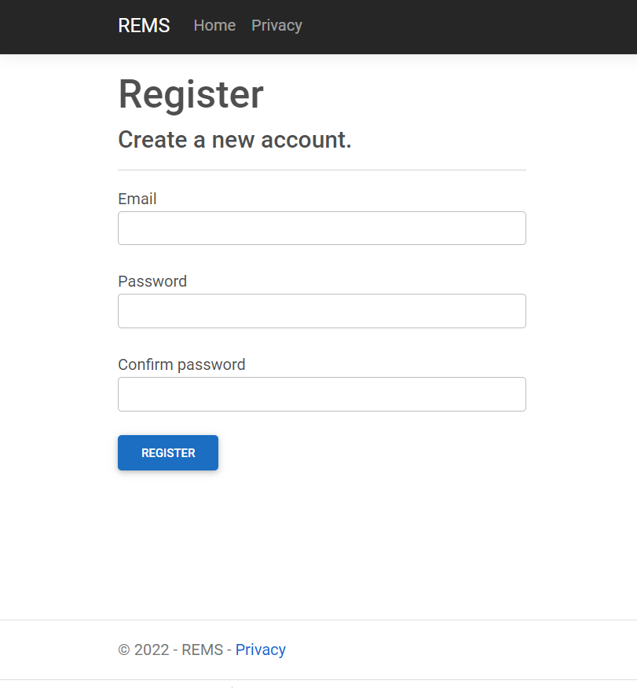
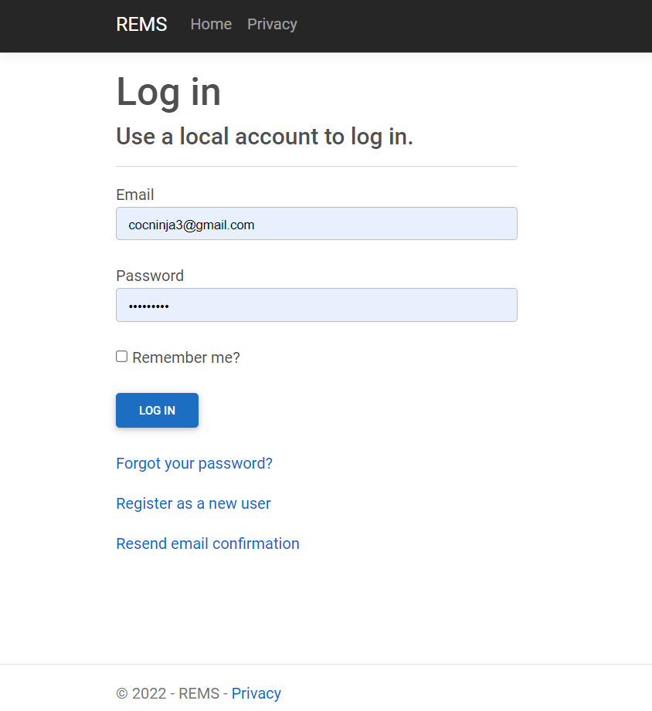
Preview of website:

Slide 5
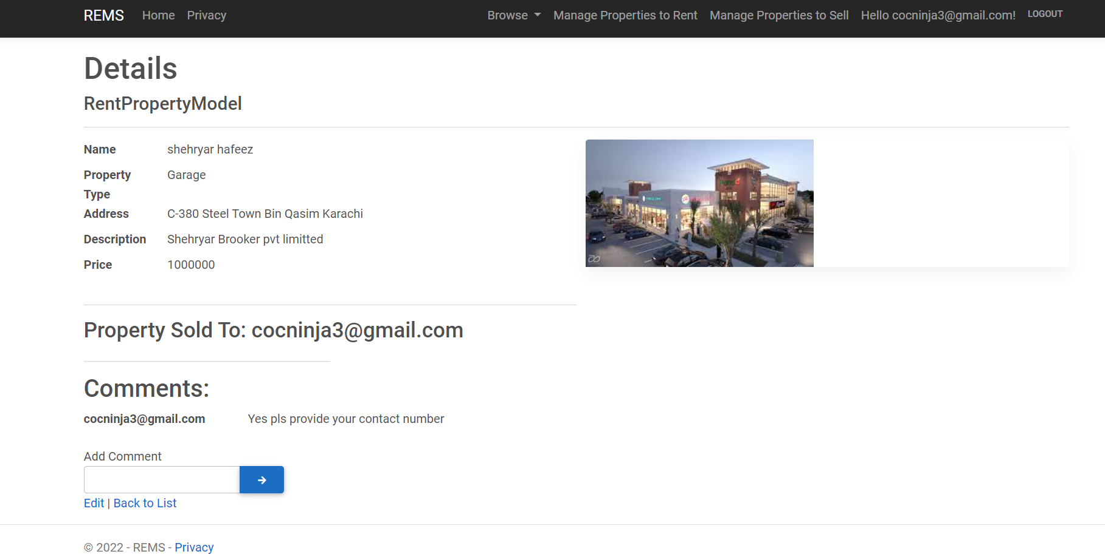
Project functions:
Register/login:
You can register yourself as a new user. As well as you can login for sure if you’re registered once.
Manage properties:
You can manage multiple properties whether they are for buying or selling.
Business
Agents:
Real estate agents can be registered.
BID:
Bid can be taken place online as well. Means you can Buy/Sell in a matter of few seconds.

Slide 6
Preview of website:
Under the supervision of Prof. Dr Ghufran Ullah we were able to complete the project. He was very kind to help us through out the journey. Professor was very concerned through-out the term, always keeping check and balance on each individual.

Slide 7

Thank You
Than

